Slide 1
Factor Analysis
Team members:
Aryan Mishra ; Ajayraj Pasi
Eknath ; Parth ; Amol

Slide 2
Table of contents
01
02
03
06
05
04
Objectives
Adequecy tests
Principal Component
Conclusion
Regression model
Factor analysis

Slide 3
Objective of Project
1)Delve into the complex interplay of attitudes and experiences
surrounding statistics, mathematics, SPSS, and computers.
2)By applying factor analysis and logistic regression to the
dataset, psychological dimensions and predictive factors that
influence individuals' perceptions and behaviors in these
domains to explore statistics anxiety among students and its
influence on career choices in statistics.
3) Understand the underlying dimensions of anxiety and predict
career preferences based on these factors.

Slide 4
About the data
The dataset consists of statements related to attitudes, emotions, and experiences regarding statistics, mathematics, SPSS, and computers.
This dataset, sourced from Andy Field's textbook resources, comprises survey responses from 10th-grade to BSc level students regarding their attitudes towards statistics.
It's designed to assess statistics anxiety and guide career choices in statistics. Accessible via commres.net, the dataset aids in understanding students' perspectives on statistics, potentially influencing their career decisions and educational directions.

Slide 5
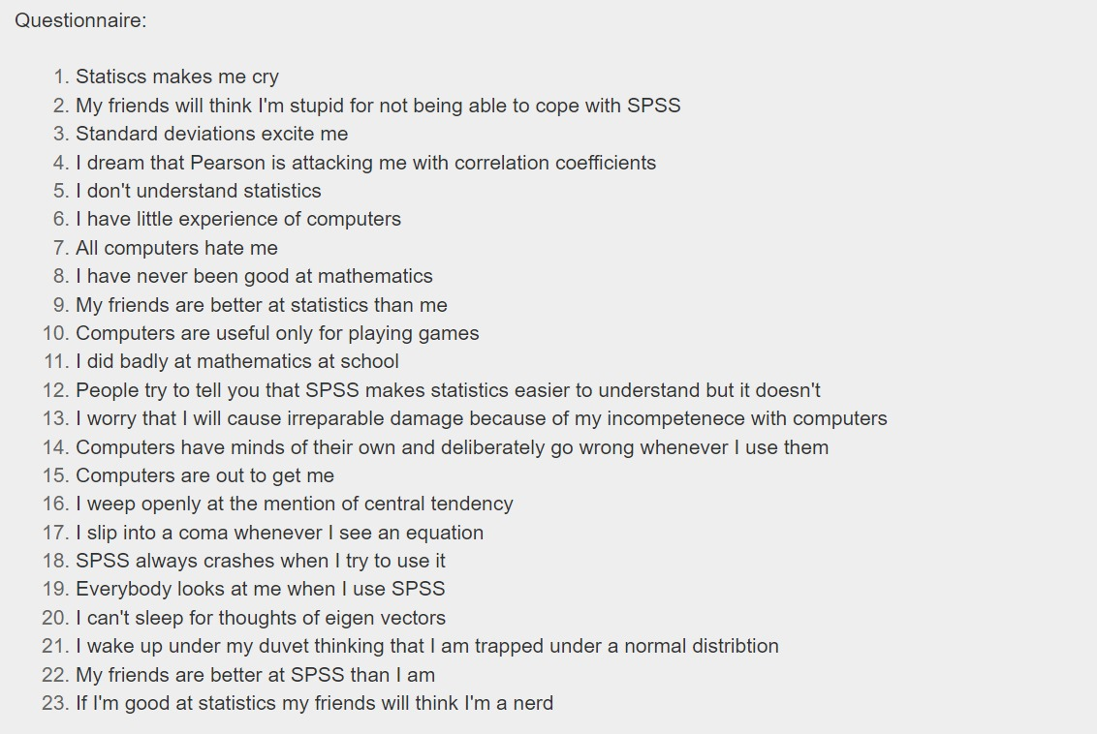

Slide 6
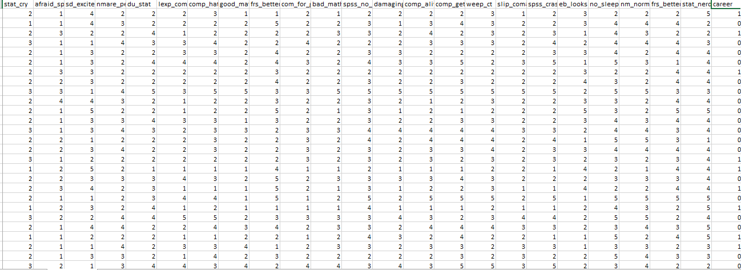
Layout of Statcareer data

Slide 7
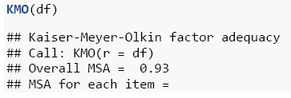
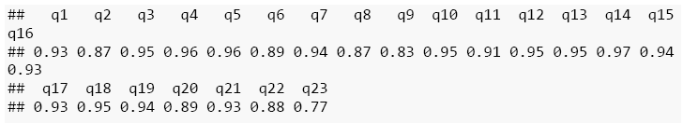
Factor Tests
Kaiser-Meyer-Olkin factor adequacy :
Condition:
KMO value >=0.5 – Acceptable data
KMO value <0.5 – Unacceptable data

Slide 8
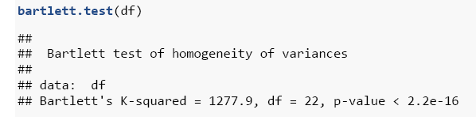
Bartlett’s test of sphericity :
Hypothesis:
H_{o} : Correlation matrix is an identity matrix
V/S
H₁ :Correlation matrix is not an identity matrix

Slide 9
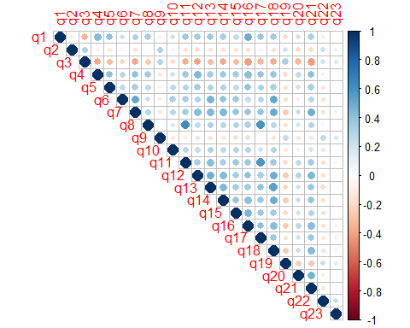
Correlation plot :
Correlation coefficients range from -1 to 1, where
1 indicates a perfect positive correlation,
-1 indicates a perfect negative correlation
0 indicates no correlation.

Slide 10
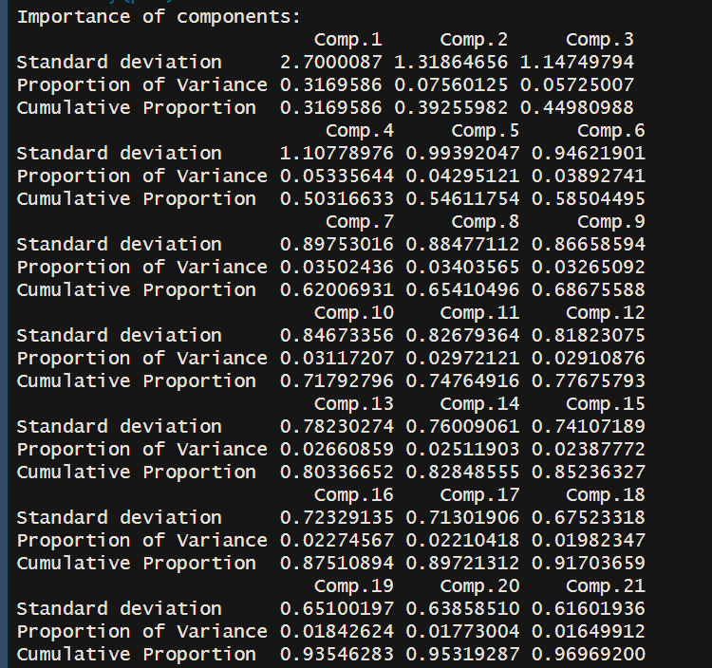
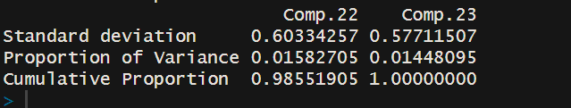
Principal Component Analysis :
The first component explains 31.7% of the variance, and the cumulative proportion of variance explained by the first four components is 50.3%.

Slide 11
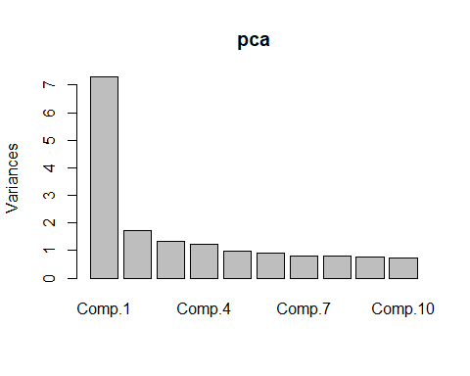
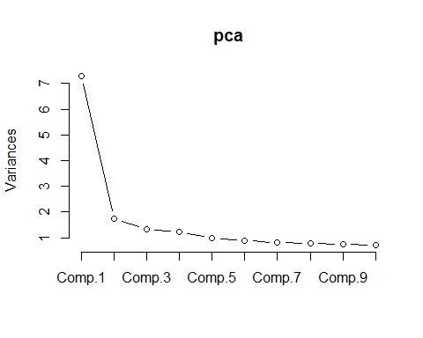

Slide 12
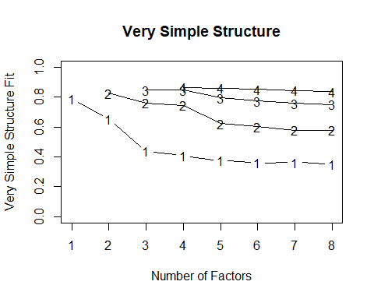
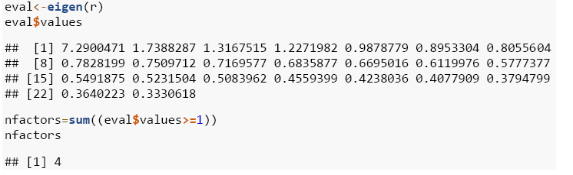
Very Simple Structure (VSS) :
Selecting no of factors :
By eigen value criteria

Slide 13
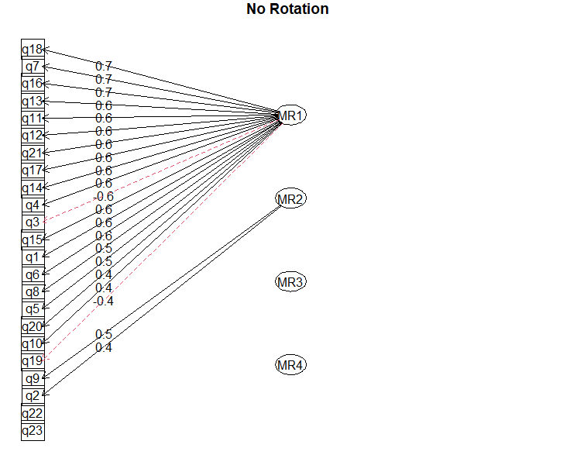
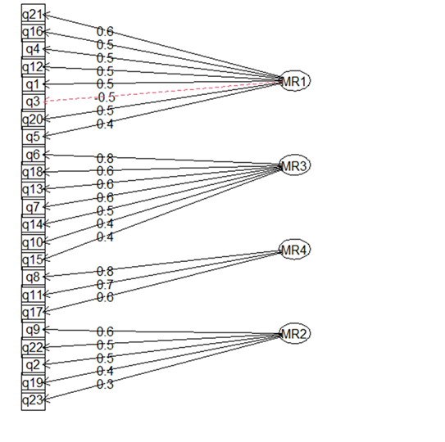
Applying Rotation
No Rotation :
Varimax Rotation :

Slide 14
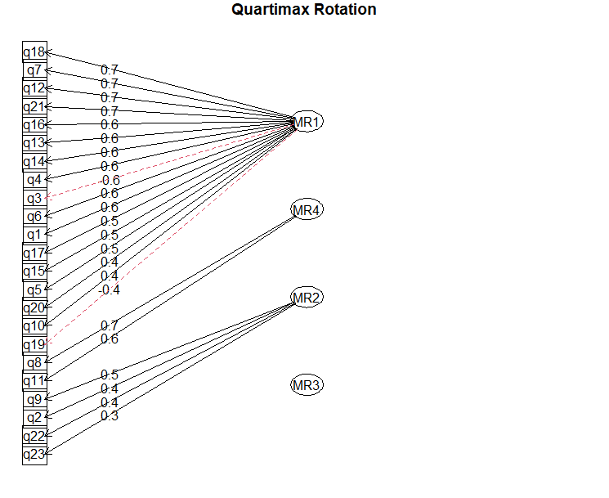
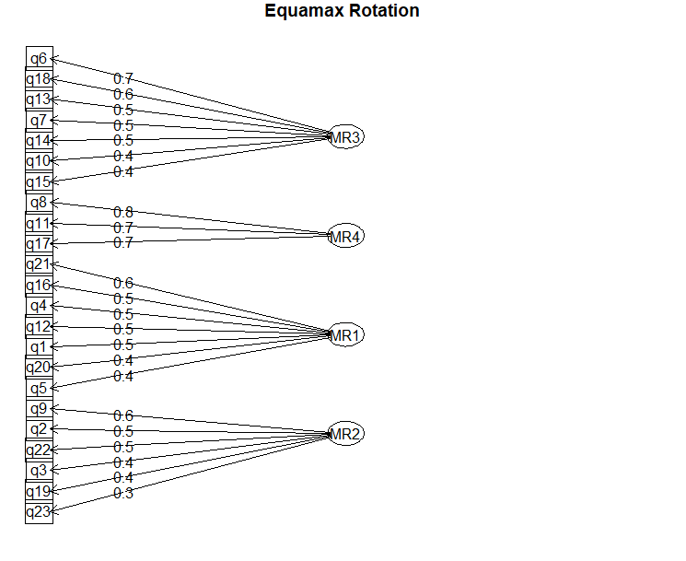
Quartimax Rotation :
Equimax Rotation :

Slide 15
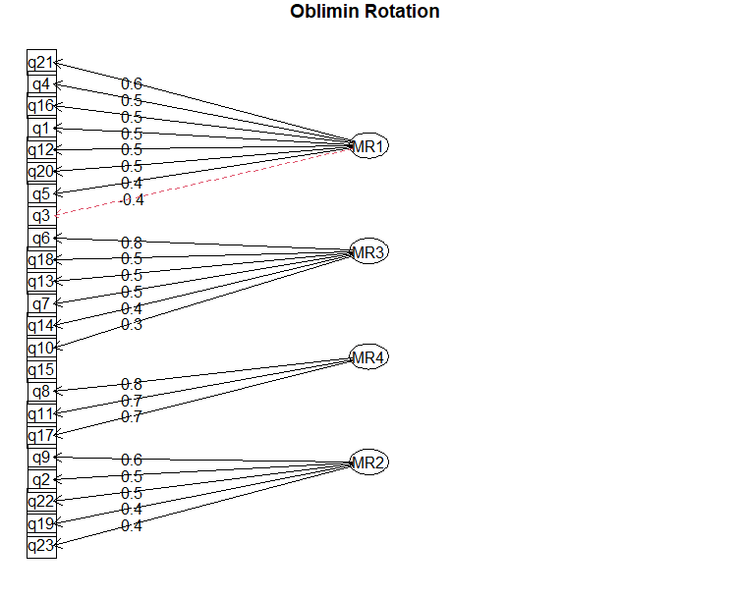
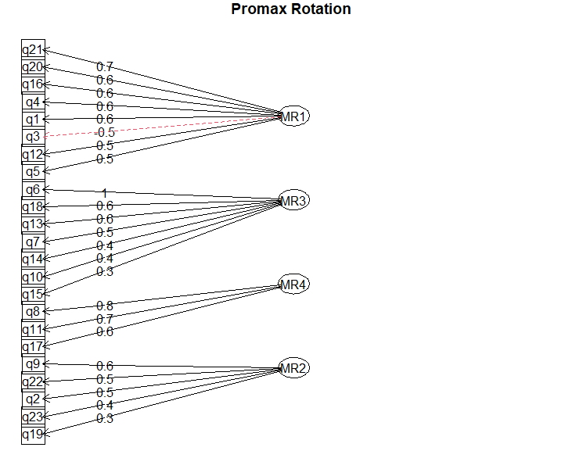
Promax Rotation :
Oblimin Rotation :

Slide 16
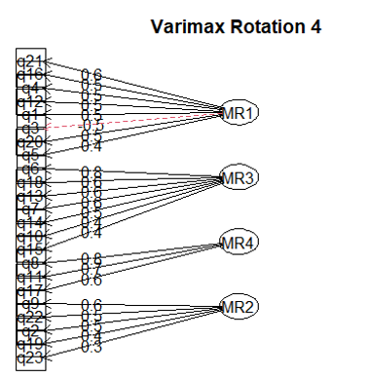
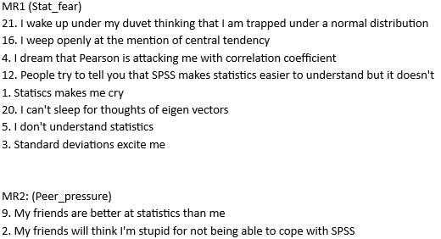
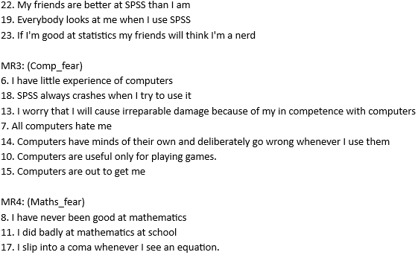
Final Rotation
Varimax – 4 Factors
Statistics fear
Computer fear
Maths fear
Peer Pressure

Slide 17
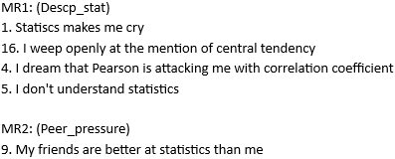
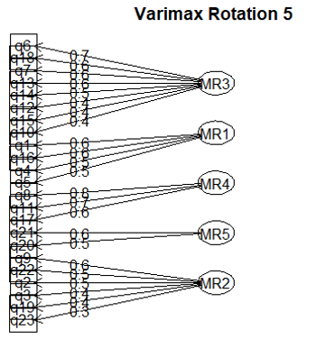
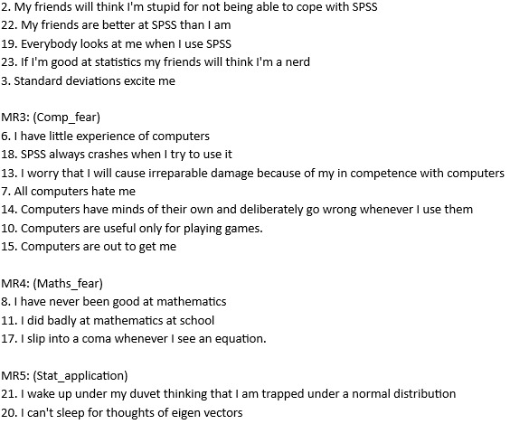
Varimax – 5 Factors
Computer fear
Descriptive stats
Maths fear
Stats application
Peer Pressure

Slide 18

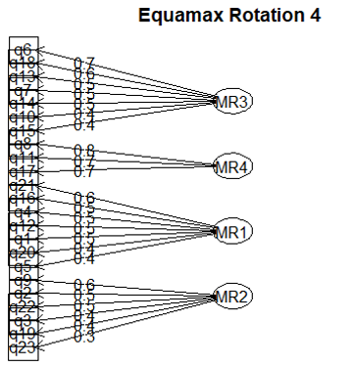
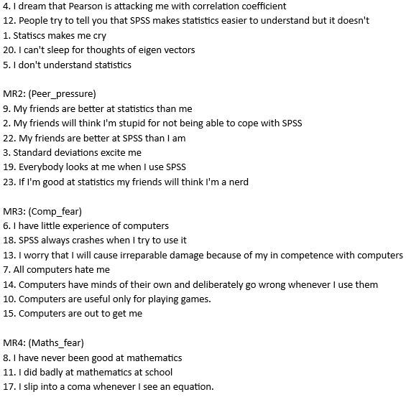
Equamax – 4 Factors
Computer fear
Maths fear
Statistics fear
Peer Pressure

Slide 19
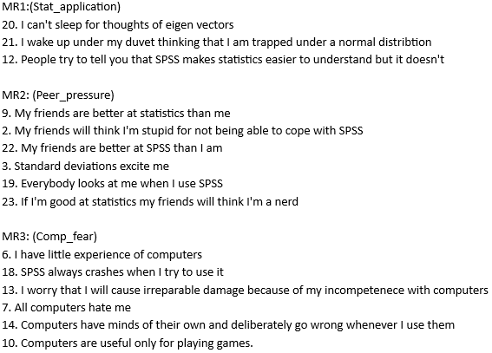
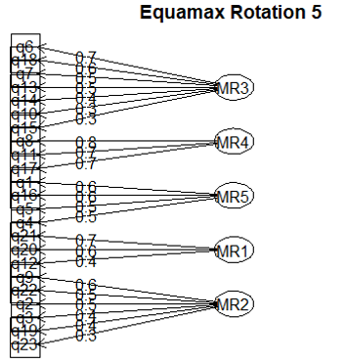
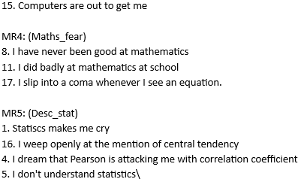
Equamax – 5 Factors
Computer fear
Maths fear
Descriptive stats
Stats application
Peer Pressure

Slide 20

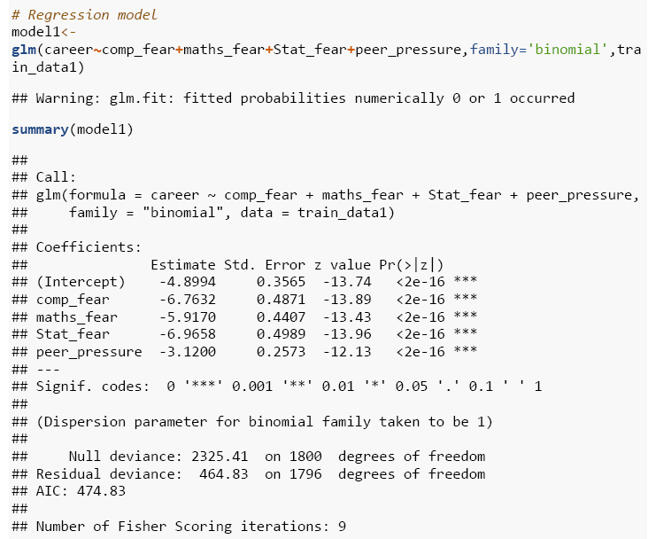
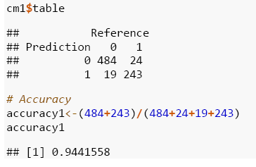
Regression model
Equamax with 4 factors
Model Accuracy
TP | FP
FN | TN

Slide 21
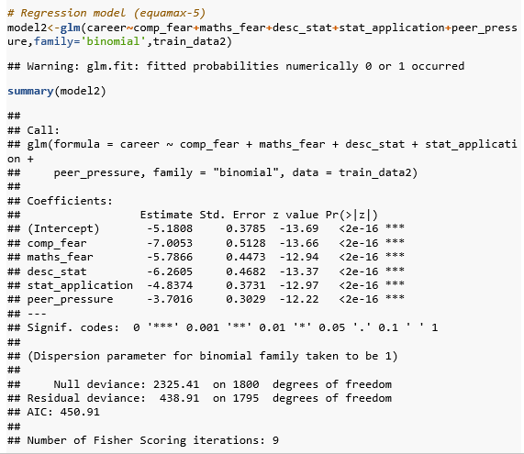
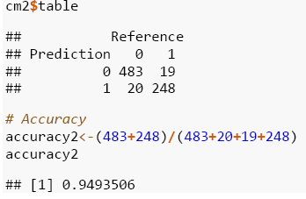
Regression model
2. Equamax with 5 factors
Model Accuracy

Slide 22
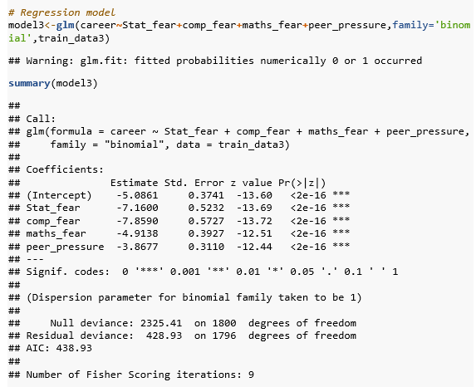
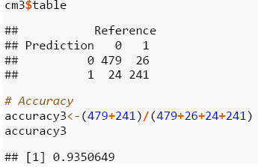
Regression model
3. Varimax with 4 factors
Model Accuracy

Slide 23
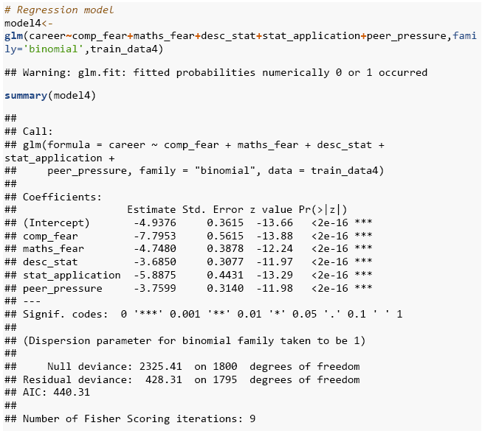
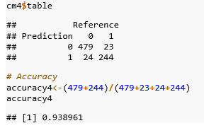
Regression model
4. Varimax with 5 factors
Model Accuracy

Slide 24




Conclusion
Best Model
Model 1 - Equa (4)
Model 2 - Equa (5)
The best model can be concluded as the model 2
with Equamax rotation and
with 5 factors as its accuracy is the heighest
from the rest of the model
Model 3 - Vari (4)
Model 4 - Vari (5)
Computer fear
Maths fear
Descriptive stats
Stats application
Peer Pressure
Final Factors

Slide 25
Thanks!

